Slide 1
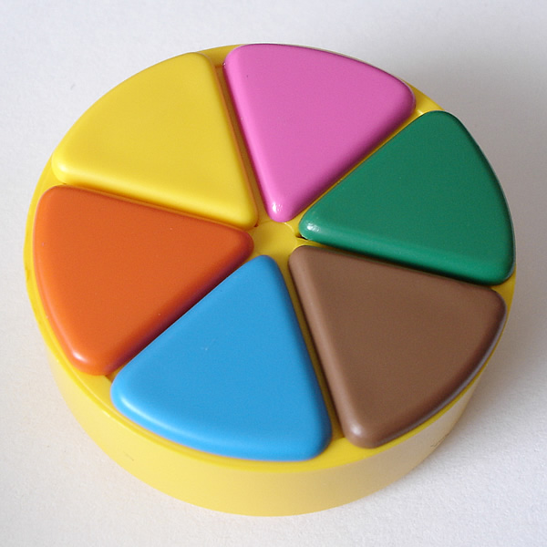
ALGEBRA TRIVIAL

Slide 2
VOCABULARY
FIRST DEGREE EQUATION | FIRST DEGREE EQUATION WITH BRACKETS AND DENOMINATORS | INCOMPLETED SECOND DEGREE EQUATION | COMPLETED SECOND DEGREE EQUATION | SECOND DEGREE EQUATION WITH NOTABLE PRODUCTS | SYSTEM OF EQUATIONS
30 seconds | 1,5 minutes | 1 minute | 2 minutes | 5 minutes | 3 minutes

Slide 3
RULES
Groups of 4-5 students
Throw die
Advance on the board
Answer the question (the time varies depending on the color of the question)
If one team fails, send the question to another team
The team that manages to answer a question of each color correctly wins.

